Slide 1
Module3_Deadlocks
Reference: “OPERATING SYSTEM CONCEPTS”, ABRAHAM SILBERSCHATZ, PETER BAER GALVIN, GREG GAGNE , Wiley publications.

Slide 2
Deadlocks- Topics
System Model
Deadlock Characterization
Methods for Handling Deadlocks
Deadlock Prevention
Deadlock Avoidance
Deadlock Detection
Recovery from Deadlock

Slide 3
The Deadlock Problem
A set of blocked processes each holding a resource and waiting to acquire a resource held by another process in the set.
Example
  System has 2 disk drives.
  P₁ and P₂ each hold one disk drive and each needs another one.
Example
  Semaphores A and B, initialized to 1
        P₀ P₁
        wait (A); wait(B)
        wait (B); wait(A)

Slide 4
Bridge Crossing Example
Traffic only in one direction.
Each section of a bridge can be viewed as a resource.
If a deadlock occurs, it can be resolved if one car backs up (preempt resources and rollback).
Several cars might have to be backed up if a deadlock occurs.
Starvation is possible.

Slide 5
System Model
System consists of resources
Resource types R₁, R₂, . . ., R_{m}
    CPU cycles, memory space, I/O devices
Each resource type R_{i} has W_{i} instances.
Each process utilizes a resource as follows:
  request
  use
  release

Slide 6
Deadlock Characterization
Deadlock can arise if four conditions hold simultaneously.
Mutual exclusion: only one process at a time can use a resource
Hold and wait: a process holding at least one resource is waiting to acquire additional resources held by other processes
No preemption: a resource can be released only voluntarily by the process holding it, after that process has completed its task
Circular wait: there exists a set {P₀, P₁, …, P_{n}} of waiting processes such that
  P₀ is waiting for a resource that is held by P₁,
  P₁ is waiting for a resource that is held by P₂, …,
  P_{n–1} is waiting for a resource that is held by P_{n}, and
  P_{n} is waiting for a resource that is held by P₀.

Slide 7
Deadlock with Mutex Locks
Deadlocks can occur via system calls, locking, etc.

Slide 8
Resource-Allocation Graph
A set of vertices V and a set of edges E.
V is partitioned into two types:
  P = {P₁, P₂, …, P_{n}}, the set consisting of all the processes in the system
  R = {R₁, R₂, …, R_{m}}, the set consisting of all resource types in the system
request edge – directed edge P_{i} → R_{j}
assignment edge –directed edge R_{j} → P_{i}

Slide 9
Resource-Allocation Graph (Cont.)
Process
Resource Type with 4 instances
P_{i} requests instance of R_{j}
P_{i} is holding an instance of R_{j}
P_{i}
R_{j}
P_{i}
R_{j}

Slide 10
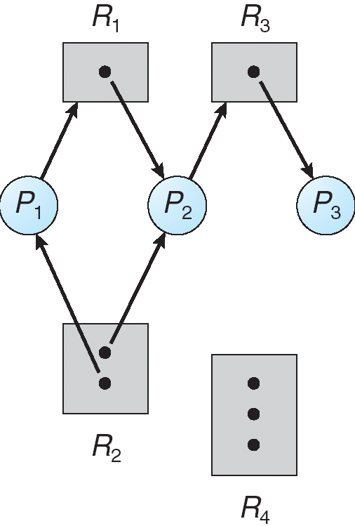
Example of a Resource Allocation Graph

Slide 11
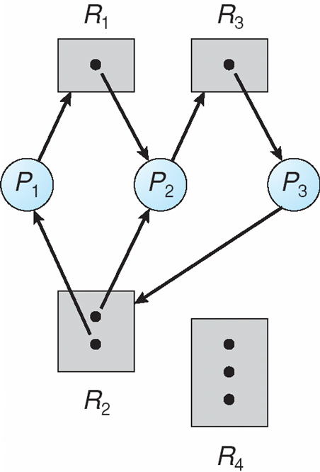
Resource Allocation Graph With A Deadlock

Slide 12
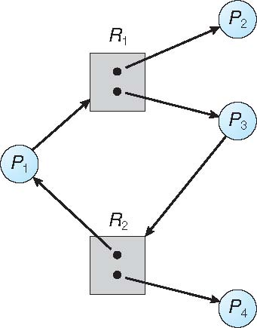
Graph With A Cycle But No Deadlock

Slide 13
Basic Facts
If graph contains no cycles ⇒ no deadlock
If graph contains a cycle ⇒
  if only one instance per resource type exists, then deadlock
  if several instances per resource type exists, possibility of deadlock

Slide 14
Methods for Handling Deadlocks
Ensure that the system will never enter a deadlock state:
  Deadlock prevention
  Deadlock avoidance
Allow the system to enter a deadlock state and then recover
Ignore the problem and pretend that deadlocks never occur in the system;
  used by most operating systems, including UNIX

Slide 15
Deadlock Prevention
Restrain the ways request can be made
Mutual Exclusion – not required for sharable resources (e.g., read-only files); must hold for non-sharable resources
Hold and Wait – must guarantee that whenever a process requests a resource, it does not hold any other resources
  Require process to request and be allocated all its resources before it begins execution
    Low resource utilization
    (or)
  Allow process to request resources only when the process has none allocated to it.
    Starvation is possible

Slide 16
Deadlock Prevention (Cont.)
No Preemption –
  If a process that is holding some resources, requests another resource that cannot be immediately allocated to it, then all resources currently being held are released(preempted)
    Preempted resources are added to the list of resources for which the process is waiting
    Process will be restarted only when it can regain its old resources, as well as the new ones that it is requesting
    (or)
  If a process requests some resources, we ﬁrst check whether they are available.
    If they are, we allocate them.
    If they are not, we check whether they are allocated to some other process that is waiting for additional resources.
      If so, we preempt the desired resources from the waiting process and allocate them to the requesting process.
    If the resources are neither available nor held by a waiting process, the requesting process must wait. While it is waiting, some of its resources may be preempted, but only if another process requests them. A process can be restarted only when it is allocated the new resources it is requesting and recovers any resources that were preempted while it was waiting.

Slide 17
Deadlock Prevention (Cont.)
Circular Wait – One way to ensure that this condition never holds is to impose a total ordering of all resource types and to require that each process requests resources in an increasing order of enumeration.
  Let R = {R1, R2, ..., Rm} be the set of resource types.
  Assign to each resource type a unique integer number, which allows to compare two resources and determine whether one precedes another in our ordering.
  Formally, a one-to-one function F: R→N, is defined where N is the set of natural numbers.
  E.g., If the set of resource types R includes tape drives, disk drives, and printers, then the function F might be deﬁned as follows:
    F(tape drive)= 1, F(disk drive)= 5, F(printer) = 12
  Protocol to prevent deadlocks: Each process can request process resources only in an increasing order of enumeration.
    A process can initially request any number of instances of a resource type —say, Ri. After that, the process can request instances of resource type Rj if and only if F(Rj) > F(Ri).
    E.g: A process that needs to use the tape drive and printer at the same time must ﬁrst request the tape drive and then request the printer.
    Alternatively, we can require that a process requesting an instance of resource type Rj must have released any resources Ri such that F(Ri) ≥ F(Rj).
  If the two protocol mentioned above is used, then the circular-wait condition cannot hold.
    Proof by contradiction:Assume that a circular wait exists. Let the set of processes involved in the circular wait be {P0, P1, ..., Pn}, where Pi is waiting for a resource Ri, which is held by process Pi+1. ( Pn is waiting for a resource Rn held by P0.) Then, since process Pi+1 is holding resource Ri while requesting resource Ri+1, we must have F(Ri) < F(Ri+1) for all i. But this condition means that F(R0) < F(R1) < ... < F(Rn) < F(R0). By transitivity, F(R0) < F(R0), which is impossible. Therefore, there can be no circular wait in the system.

Slide 18
Deadlock Example
/* Create and initialize the mutex locks */
Pthread_mutex_t first_mutex;
Pthread_mutex_t second_mutex;
pthread_mutex_init(&first_mutex,NULL);
Pthread_mutex_init(&second_mutex,NULL);
/* thread one runs in this function */
void *do_work_one(void *param)
{
pthread_mutex_lock(&first_mutex);
pthread_mutex_lock(&second_mutex);
/** * Do some work */
pthread_mutex_unlock(&second_mutex);
pthread_mutex_unlock(&first_mutex);
pthread_exit(0);
}
/* thread two runs in this function */
void *do_work_two(void *param)
{
pthread_mutex_lock(&second_mutex);
pthread_mutex_lock(&first_mutex);
/** * Do some work */
pthread_mutex_unlock(&first_mutex);
pthread_mutex_unlock(&second_mutex);
pthread_exit(0);
}

Slide 19
Deadlock Example with Lock Ordering
void transaction(Account from, Account to, double amount)
{
mutex lock1, lock2;
lock1 = get_lock(from);
lock2 = get_lock(to);
acquire(lock1);
acquire(lock2);
withdraw(from, amount);
deposit(to, amount);
release(lock2);
release(lock1);
}
Transactions 1 and 2 execute concurrently. Transaction 1 transfers $25 from account A to account B, and Transaction 2 transfers $50 from account B to account A

Slide 20
Deadlock Avoidance
Requires that the system has some additional a priori information
available
Simplest and most useful model requires that each process declare the maximum number of resources of each type that it may need
The deadlock-avoidance algorithm dynamically examines the resource-allocation state to ensure that there can never be a circular-wait condition
Resource-allocation state is defined by the number of available and allocated resources, and the maximum demands of the processes

Slide 21
Safe State
When a process requests an available resource, system must decide if immediate allocation leaves the system in a safe state
System is in safe state if there exists a sequence <P₁, P₂, …, P_{n}> of ALL the processes in the system such that for each P_{i}, the resources that P_{i} can still request could be satisfied by currently available resources + resources held by all the P_{j}, with j < i
  If P_{i} resource needs are not immediately available, then P_{i} can wait until all P_{j} have finished
  When P_{j} is finished, P_{i} can obtain needed resources, execute, return allocated resources, and terminate
  When P_{i} terminates, P_{i+1} can obtain its needed resources, and so on

Slide 22
Basic Facts
If a system is in safe state ⇒ no deadlocks
If a system is in unsafe state ⇒ possibility of deadlock
Avoidance ⇒ ensure that a system will never enter an unsafe state.

Slide 23
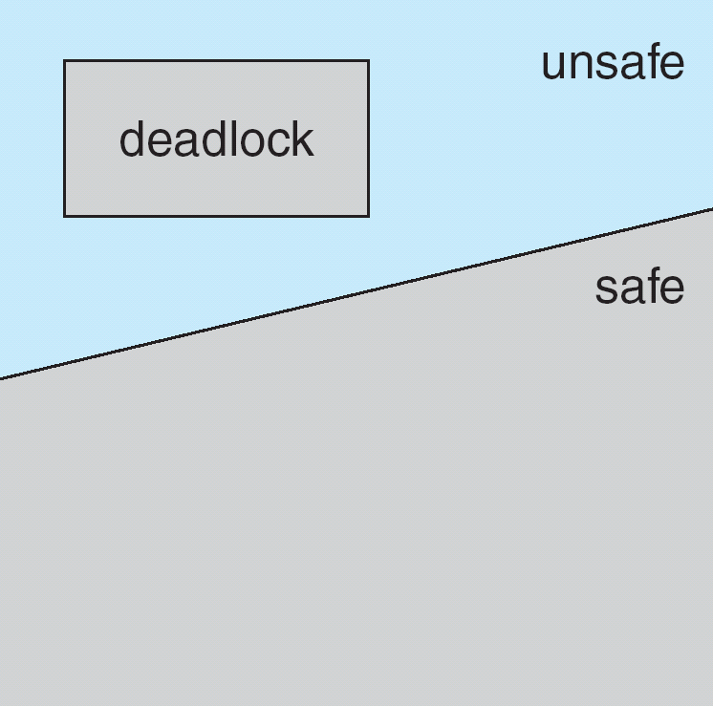
Safe, Unsafe, Deadlock State

Slide 24
Safe, Unsafe, Deadlock State
In an unsafe state, OS cannot prevent processes from requesting resources in such a way that a deadlock occurs.
The behavior of the processes controls unsafe states.
  E.g , we consider a system with 12 magnetic tape drives and 3 processes: P0, P1, andP2. Consider the snapshot of the system at time t0 as given below in the table. Then there are three free tape drives.
  At time t0, the system is in a safe state. The sequence <P1, P0, P2> satisﬁes the safety condition.
A system can go from a safe state to an unsafe state.
  Suppose that, at time t1, process P2 requests and is allocated one more tape drive.
  The system is no longer in a safe state. At this point, only process P1 can be allocated all its tape drives. When it returns them, the system will have only four available tape drives. Similarly, process P2 may request six additional tape drives and have to wait, resulting in a deadlock.
    Solution: P2 should have been put under wait state wait until either of the other processes had ﬁnished and released its resources
 | Maximum Needs | Current Allocation
P0 | 10 | 5
P1 | 4 | 2
P2 | 9 | 2

Slide 25
Avoidance Algorithms
Single instance of a resource type
  Use a Resource-Allocation Graph (RAG)
Multiple instances of a resource type
  Use the Banker’s algorithm

Slide 26
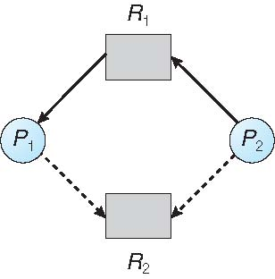
Resource-Allocation Graph Scheme
Claim edge P_{i} → R_{j} indicates that process P_{j} may request resource R_{j}; represented by a dashed line
Claim edge converts to request edge when a process requests a resource
Request edge is converted to an assignment edge when the resource is allocated to the process
When a resource is released by a process, assignment edge reconverts to a claim edge
Resources must be claimed a priori in the system

Slide 27
Resource-Allocation Graph

Slide 28
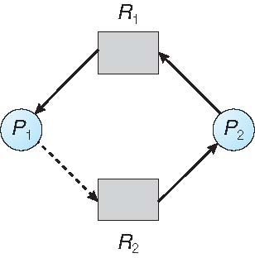
Unsafe State In Resource-Allocation Graph

Slide 29
Resource-Allocation Graph Algorithm
Suppose that process P_{i} requests a resource R_{j}
The request can be granted only if converting the request edge to an assignment edge does not result in the formation of a cycle in the resource allocation graph.

Slide 30
Banker’s Algorithm
Multiple instances of resources exists
Each process must a priori claim maximum use
When a process requests a resource it may have to wait
When a process gets all its resources it must return them in a finite amount of time

Slide 31
Data Structures for the Banker’s Algorithm
Let n = number of processes, and m = number of resources types
Time-varying data structures:
Available: Vector of length m. If available [j] = k, there are k instances of resource type R_{j} available
Max: n x m matrix. If Max [i,j] = k, then process P_{i} may request at most k instances of resource type R_{j}
Allocation: n x m matrix. If Allocation[i,j] = k then P_{i} is currently allocated k instances of R_{j}
Need: n x m matrix. If Need[i,j] = k, then P_{i} may need k more instances of R_{j} to complete its task
    Need [i,j] = Max[i,j] – Allocation [i,j]

Slide 32
Safety Algorithm
1. Let Work and Finish be vectors of length m and n, respectively. Initialize:
      Work = Available
      Finish [i] = false for i = 0, 1, …, n- 1
2. Find an i such that both (a) & (b) are true:
  (a) Finish [i] = false
  (b) Need_{i} ≤ Work
  If no such i exists, go to step 4
3. Work = Work + Allocation_{i}
Finish[i] = true
go to step 2
4. If Finish [i] == true for all i, then the system is in a safe state

Slide 33
Resource-Request Algorithm for Process P_{i}
Request_{i} = request vector for process P_{i}. If Request_{i} [j] = k then process P_{i} wants k instances of resource type R_{j}
  1. If Request_{i} ≤ Need_{i} go to step 2. Otherwise, raise error condition, since process has exceeded its maximum claim
  2. If Request_{i} ≤ Available, go to step 3. Otherwise P_{i} must wait, since resources are not available
  3. Pretend to allocate requested resources to P_{i} by modifying the state as follows:
      Available = Available – Request_{i};
      Allocation_{i} = Allocation_{i} + Request_{i};
      Need_{i} = Need_{i} – Request_{i};
    If safe ⇒ the resources are allocated to P_{i}
    If unsafe ⇒ P_{i} must wait, and the old resource-allocation state is restored

Slide 34
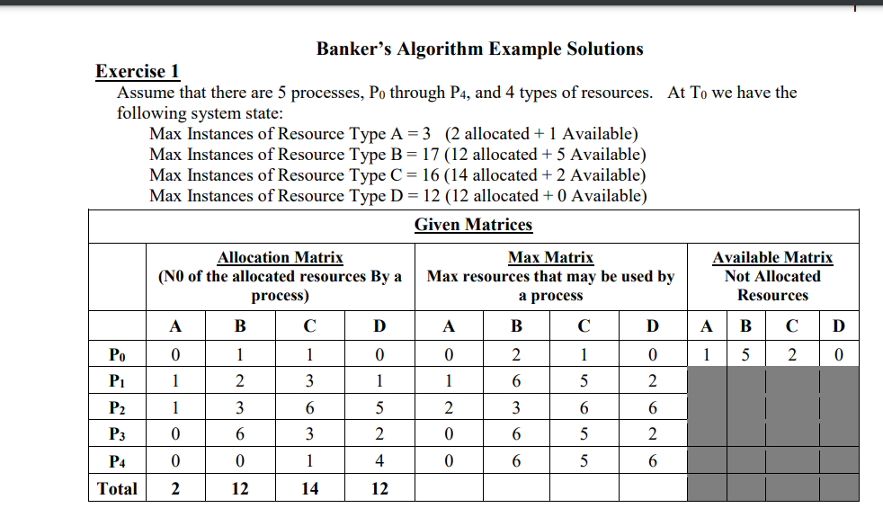

Slide 35
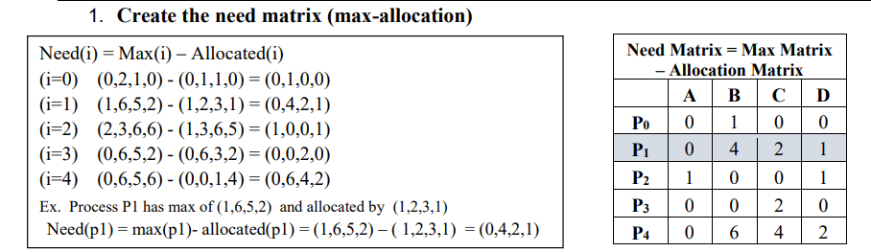
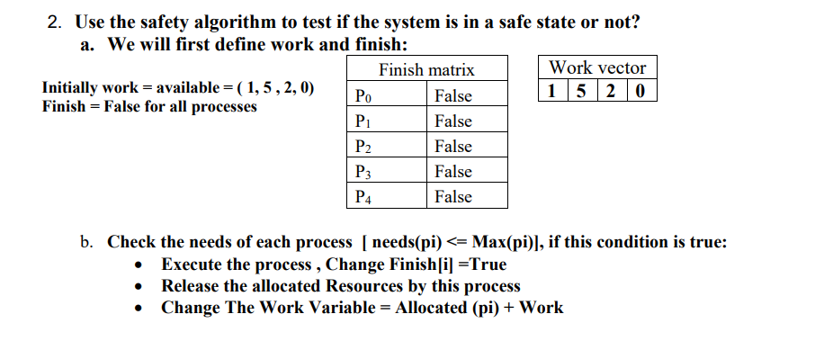
xx

Slide 36
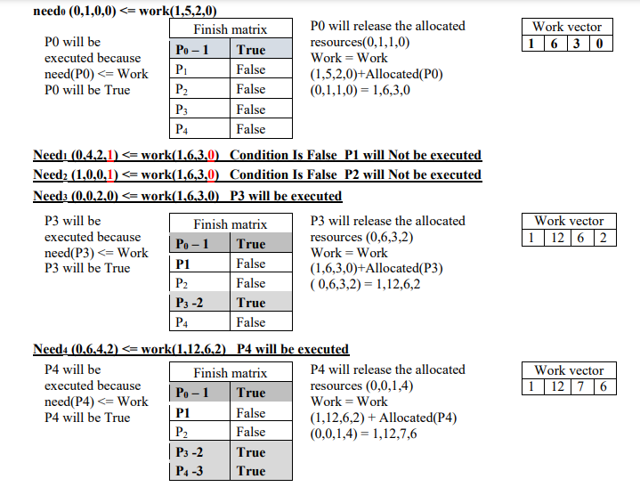
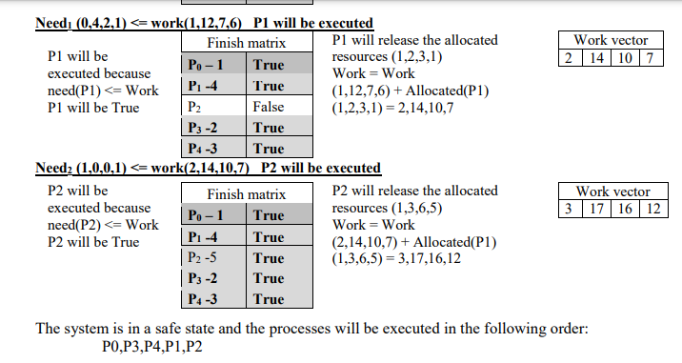

Slide 37
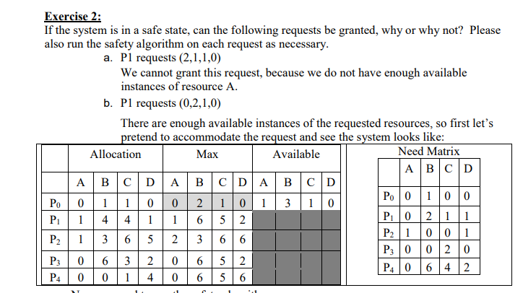

Slide 38
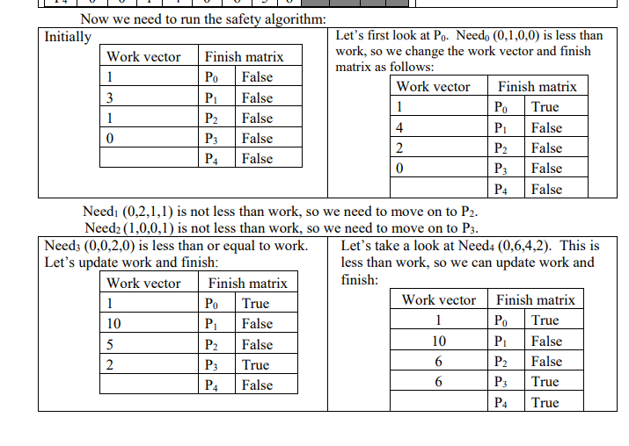

Slide 39
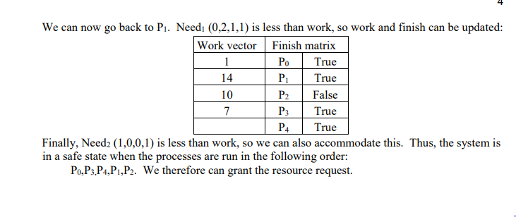

Slide 40
Example of Banker’s Algorithm
Consider a system with ﬁve processes P0 through P4 and three resource types A, B and C. Resource type A has ten instances, resource type B has ﬁve instances, and resource type C has seven instances. Suppose that, at time t0 the following snapshot of the system has been taken: Determine whether the system is in safe state.
5 processes P₀ through P₄;
3 resource types:
A (10 instances), B (5instances), and C (7 instances)
Snapshot at time T₀:
Allocation Max Available
A B C A B C A B C
P₀ 0 1 0 7 5 3 3 3 2
P₁ 2 0 0 3 2 2
P₂ 3 0 2 9 0 2
P₃ 2 1 1 2 2 2
P₄ 0 0 2 4 3 3

Slide 41
Example (Cont.)
The content of the matrix Need is defined to be Max – Allocation
Need
A B C
P₀ 7 4 3
P₁ 1 2 2
P₂ 6 0 0
P₃ 0 1 1
P₄ 4 3 1
The system is in a safe state since the sequence < P₁, P₃, P₄, P₂, P₀> satisfies safety criteria

Slide 42
Example (Cont.)
Suppose now that process P1 requests one additional instance of resource type A and two instances of resource type C, so Request1 = <1,0,2>
  Can this request by P₁ be granted?

Slide 43
Example (cont’d): P₁ Request (1,0,2)
Check if Request ≤ Available (that is, <1,0,2> ≤ <3,3,2> ⇒ true
Allocation Need Available
A B C A B C A B C
P₀ 0 1 0 7 4 3 2 3 0
P₁ 3 0 2 0 2 0
P₂ 3 0 2 6 0 0
P₃ 2 1 1 0 1 1
P₄ 0 0 2 4 3 1
Executing safety algorithm shows that sequence < P₁, P₃, P₄, P₀, P₂> satisfies the safety requirement.
  Hence , the request by P₁ can be granted immediately

Slide 44
Example (cont’d)
Can request for <3,3,0> by P₄ be granted?
  No, since the resources are not available (current availability is (2,3,0)).
Can request for (0,2,0) by P₀ be granted?
  No (though the resources are available, the resulting state is unsafe).

Slide 45
Deadlock Detection
If a system does not employ either a deadlock-prevention or a deadlock avoidance algorithm, then a deadlock situation may occur.
  Allow the system to enter deadlock state
In this environment, the system may provide
  Detection algorithm
  Recovery scheme
(At an additional overhead of run-time costs in maintaining the necessary information and executing the detection algorithm and also the potential losses inherent in recovering from a deadlock)

Slide 46
Deadlock Detection - Single Instance of Each Resource Type
Maintain wait-for graph (obtained from RAG, by removing resources nodes and collapsing edges appropriately)
  Nodes are processes
  P_{i} → P_{j} if P_{i} is waiting for P_{j}
    P_{i} → R_{q} and R_{q} → P_{j}
Periodically invoke an algorithm that searches for a cycle in the graph. If there is a cycle, there exists a deadlock
An algorithm to detect a cycle in a graph requires an order of n² operations, where n is the number of vertices in the graph.

Slide 47
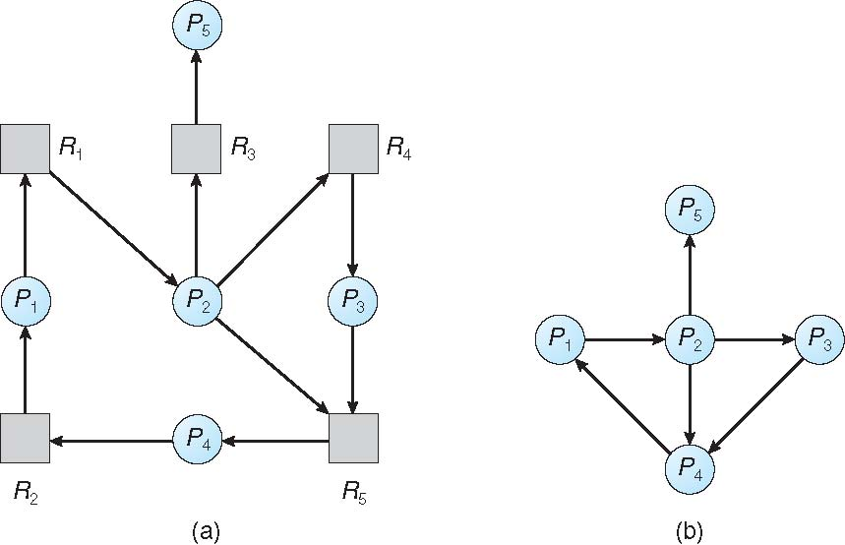
Deadlock Detection – Resource Allocation Graph and Wait-for Graph
Resource-Allocation Graph
Corresponding wait-for graph

Slide 48
Deadlock Detection -Several Instances of a Resource Type
Available: A vector of length m indicates the number of available resources of each type
Allocation: An n x m matrix defines the number of resources of each type currently allocated to each process
Request: An n x m matrix indicates the current request of each process. If Request [i][j] = k, then process P_{i} is requesting k more instances of resource type R_{j}.

Slide 49
Deadlock Detection Algorithm - Several Instances of a Resource Type
1. Let Work and Finish be vectors of length m and n, respectively Initialize:
  (a) Work = Available
  (b) For i = 1,2, …, n, if Allocation_{i} ≠ 0, then
  Finish[i] = false; otherwise, Finish[i] = true
2. Find an index i such that both:
  (a) Finish[i] == false
  (b) Request_{i} ≤ Work
  If no such i exists, go to step 4
3. Work = Work + Allocation_{i}
Finish[i] = true
go to step 2
4. If Finish[i] == false, for some i, 1 ≤ i ≤ n, then the system is in deadlock state. Moreover, if Finish[i] == false, then P_{i} is deadlocked
Algorithm requires an order of O(m x n²) operations to detect whether the system is in deadlocked state

Slide 50
Example of Detection Algorithm
Consider a system with Five processes P₀ through P₄; three resource types
A (7 instances), B (2 instances), and C (6 instances)
Snapshot at time T₀ (resource-allocation state):
Allocation Request Available
A B C A B C A B C
P₀ 0 1 0 0 0 0 0 0 0
P₁ 2 0 0 2 0 2
P₂ 3 0 3 0 0 0
P₃ 2 1 1 1 0 0
P₄ 0 0 2 0 0 2
Sequence <P₀, P₂, P₃, P₁, P₄> will result in Finish[i] = true for all i.
Hence, the system is not in a deadlocked state.

Slide 51
Example of Detection Algorithm(Cont’d)
Suppose now that process P₂ requests an additional instance of type C
  Request matrix is modified as follows:
Request
A B C
P₀ 0 0 0
P₁ 2 0 2
P₂ 0 0 1
P₃ 1 0 0
P₄ 0 0 2
State of system?
  Can reclaim resources held by process P₀, but insufficient resources to fulfill other processes requests
  Deadlock exists, consisting of processes P₁, P₂, P₃, and P₄

Slide 52
Detection-Algorithm Usage
When, and how often, to invoke the algorithm depends on:
  How often a deadlock is likely to occur?
  How many processes will be affected by deadlock when it happens?
    How many processes will need to be rolled back?
      one for each disjoint cycle

Slide 53
Detection-Algorithm Usage (cont’d)
If deadlocks occur frequently, then the detection algorithm should be invoked frequently
  Resources allocated to deadlocked processes will be idle until the deadlock can be broken
  Number of processes involved in the deadlock cycle may grow
Deadlocks occur only when some process makes a request that cannot be granted immediately.
  This request may be the final request that completes a chain of waiting processes.
In the extreme case , we can invoke the deadlock detection algorithm every time a request for allocation cannot be granted immediately.
  We can identify not only the deadlocked set of processes but also the specific process that “caused” the deadlock.
  One request may create many cycles in the resource graph “caused” by the one identifiable process
    Incurs considerable overhead in computation time.
Alternatively, invoke the algorithm at defined intervals
  Once per hour or Whenever CPU utilization drops below 40 percent.
A deadlock eventually cripples system throughput and causes CPU utilization to drop.
If detection algorithm is invoked arbitrarily, there may be many cycles in the resource graph and so we would not be able to tell which of the many deadlocked processes “caused” the deadlock.

Slide 54
Recovery from Deadlock
When a detection algorithm determines that a deadlock exists:
  One possibility is to inform the operator that a deadlock has occurred and to let the operator deal with the deadlock manually.
  Another possibility is to let the system recover from the deadlock automatically.
    There are two options for breaking a deadlock.
      Abort one or more processes to break the circular wait.
      Preempt some resources from one or more of the deadlocked processes.

Slide 55
Recovery from Deadlock: Process Termination
Abort all deadlocked processes
  Will break the deadlock cycle, but at great expense.
  Deadlocked processes may have computed for a long time, and the results of these partial computations must be discarded and probably will have to be recomputed later.
Abort one process at a time until the deadlock cycle is eliminated
  Incurs considerable overhead, since after each process is aborted, a deadlock-detection algorithm must be invoked to determine whether any processes are still deadlocked.
In which order should we choose to abort? (determine which deadlocked process(es) to be terminated)
  If the process was in the midst of updating a file, terminating it will leave that file in an incorrect state.
  If the process was in the midst of printing data on a printer, the system must reset the printer to a correct state before printing the next job.
Abort those processes whose termination will incur the minimum cost.
  Many factors may affect which process is to be chosen, including:
  Priority of the process
  How long process has computed, and how much longer to completion
  Resources the process has used
  Resources process needs to complete
  How many processes will need to be terminated
  Is process interactive or batch?
The system reclaims all resources allocated to the terminated processes.

Slide 56
Recovery from Deadlock: Resource Preemption
To eliminate deadlocks using resource preemption
  successively preempt some resources from processes and give these resources to other processes until the deadlock cycle is broken.
If preemption is required to deal with deadlocks, then three issues need to be addressed:
  Selecting a victim – minimize cost
  Rollback – return to some safe state or restart process from that state
  Starvation – same process may always be picked as victim, include number of rollback in cost factor

Slide 57
Recovery from Deadlock: Resource Preemption
1.Selecting a victim ( Which resources and which processes are to be preempted?
  determine the order of preemption leading to minimize cost.
  Cost factors may include parameters like as the number of resources a deadlocked process is holding and the amount of time the process has thus far consumed.
2. Rollback (If we preempt a resource from a process, what should be done with that process?
  It cannot continue with its normal execution as it is missing some needed resource
  Roll back the process to some safe state and restart it from that state
  It is difficult to determine what a safe state is?
    Solution: Total rollback - abort the process and then restart
  Although it is more effective to roll back the process only as far as necessary to break the deadlock, this method requires the system to keep more information about the state of all running processes.
3. Starvation (How do we ensure that starvation will not occur? How can we guarantee that resources will not always be preempted from the same process? )
  If victim selection is based on cost factors:
    May be the same process is always picked as a victim
      This process never completes its designated task
    Solution: ensure that a process can be picked as a victim only a (small) finite number of times. Include the number of rollbacks in the cost factor.

